Slide 1

Spam detection classifier based on
machine learning
models
Teamwork
Leader : Taher alhamoudh
Fatima Salem Alsayone
Namerah Saleh Bin Hamam
Ogunsolu Roheem O
Imtiaz Ahmed Narejo
Massimo Bon
Shastia Mugenzi Nshuti

Slide 2





Outline:
introduction:
What is a spam email?
About the project
Data set:
What is it?
Split the dataset
Preprocessing this dataset
Applying the models
comparison between all models
conclusion

Slide 3





Introduction
Spam email:
Spam email is unsolicited and unwanted junk email sent out in bulk to an indiscriminate recipient list.
Typically, spam is sent for commercial purposes.
some people view it as unethical.
Spam email can also be a malicious attempt to gain access to your computer!

Slide 4





About the project
The goal of our project is to identify whether an email is spam or ham.
We took a dataset of labeled email messages and applied classification techniques; & we used also NLP techniques to the subject section of the dataset.
We tested each model for accuracy and performance on unclassified email messages.
We used confusion matrix also to measure recall ,precision.

Slide 5



Text or subject:
we have around 5173 sample email written
Data set:
Spam Mails dataset
Label:
Spam or ham
Label_num:
0: for ham
1: for spam
We have really simple dataset!
Id for the record ( in order to know how the shuffle of the email work next).

Slide 6

Split the dataset
We gave the model the features(x) and its answers(y)to train on
We make split for our data set into:
X_train
Train the model
Train:
4136
y_train
X_test
we test the model by giving it another set of futures(x) and wait for the answers (y).
test the model
Test:
y_test
0.2*5171=1035

Slide 7

Preprocessing
stop_words
lowercase = True
The lowercase parameter has a default value of True which converts all of our text to its lower case form
we are dealing with small email text.
So; we do not need to remove stop words in this case.
CountVectorizer()
punctuation
ignores all punctuation marks and treats them as delimiters.
accepting alphanumeric strings of length greater than or equal to 2
return a matrix of token counts

Slide 8

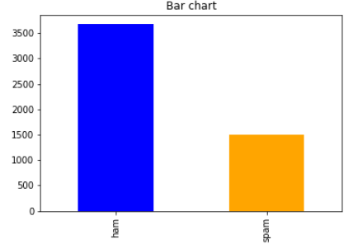
Spam & ham count:
By separate our emails according to label ; we get:
Ham emails:3672
Spam:1499

Slide 9

Applying the models

Slide 10
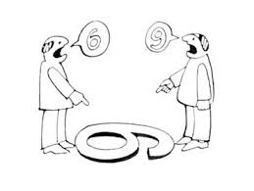

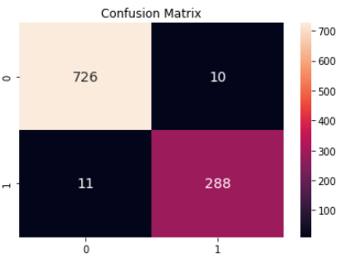
naive bayes
After applying multinomial classification we get the following results with accuracy:0.98; & recall: 0.95
1: spam
0: ham

Slide 11

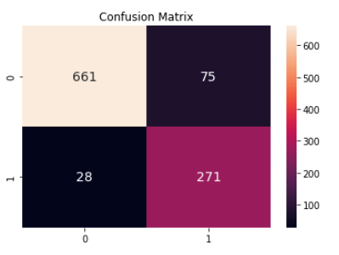
KNN classifier
N=1
After applying Knn n=1 classification we get the following results with accuracy:0.90, & recall: 0.87
1: spam
0: ham

Slide 12
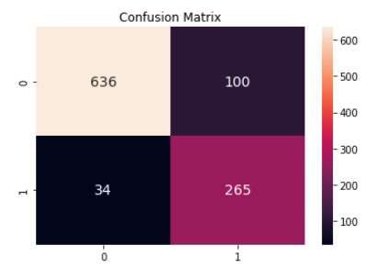
KNN classifier
N=3
After applying Knn n=3 classification we get the following results with accuracy:0.85. & recall: 0.88
1: spam
0: ham

Slide 13

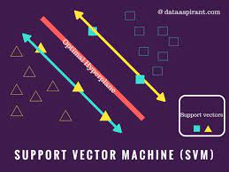
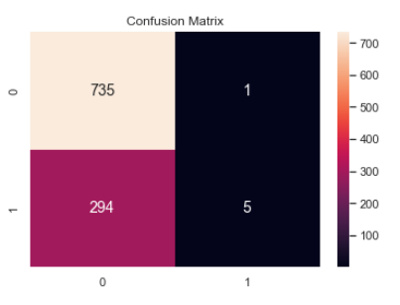
SVM classifier
After applying SVM classification with gamma=0.5 and C=0.1 we get the following results with accuracy:0.71. & recall:0.01
1: spam
0: ham

Slide 14

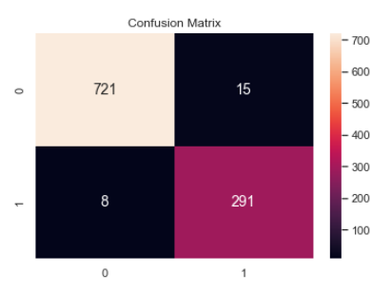
logistic regression classifier
After applying logistic regression classification with random_stat=0; we get the following results with accuracy:0.98. & recall: 0.97.
1: spam
0: ham

Slide 15
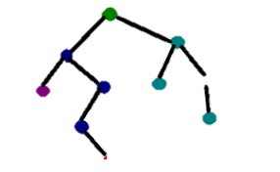
Decision Tree Classifier
We tried on deferent depth
After applying decision tree classification with random_stat=0 & max depth =2; we get accuracy:0.79.
depth | 1 | 2 | 3 | 4 | 5
score | 0.71 | 0.794 | 0.791 | 0.80 | 0.82

Slide 16


We changed the vectorizer function and get the following results…

Slide 17
Preprocessing
Tfidf
TF-IDF is the importance of a term is inversely related to its frequency across documents. The higher the TF-IDF score the more important or relevant the term is; as a term gets less relevant, its TF-IDF score will approach 0
TfidfVectorizer()
return a matrix of token counts

Slide 18
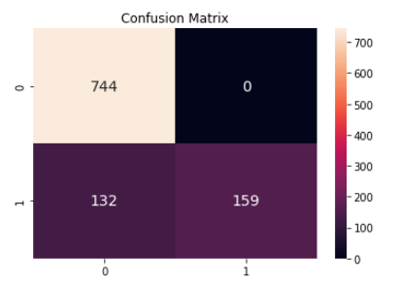
naive bayes
After applying multinomial classification we get the following results with accuracy:0.87
& recall: 0.55
1: spam
0: ham

Slide 19
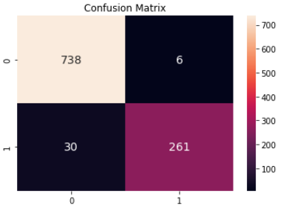
KNN classifier
N=1
After applying Knn n=1 classification we get the following results with accuracy:0.96 & recall: 0.90
1: spam
0: ham

Slide 20

KNN classifier
N=3
After applying Knn n=3 classification we get the following results with accuracy:0.96 & recall: 0.96 & recall: 0.88
1: spam
0: ham

Slide 21
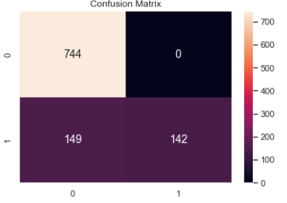
SVM classifier
After applying SVM classification with gamma=0.5 and C=0.1 we get the following results with accuracy:0.86 & recall: 0.49.
1: spam
0: ham

Slide 22
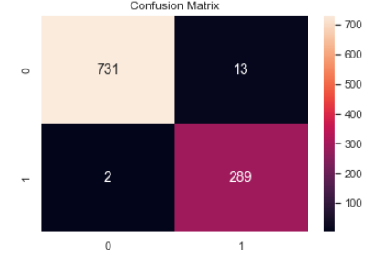
logistic regression classifier
After applying logistic regression classification with random_stat=0; we get the following results with accuracy:0.99 & recall: 0.99 !!
1: spam
0: ham

Slide 23

comparison between all models

Slide 24

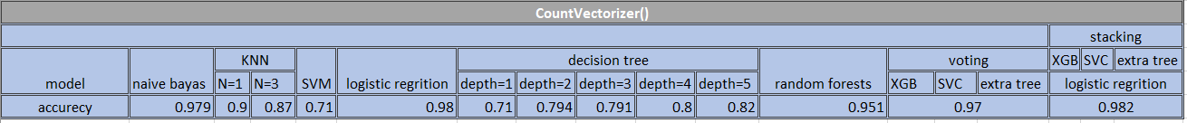
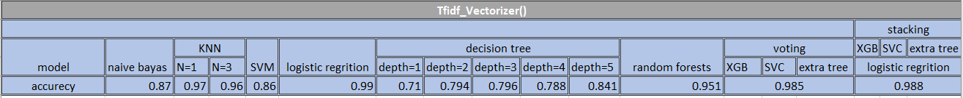

comparison table
Knowing that: tfidf_vectorizer gets results better than countVectorizer() with respect to recall; for example, the SVM model gets zero recall at count vectorizer (); but it gets 0.5 at tfidfvectorizer().

Slide 25
conclusion

Slide 26

At the end of this project, we concluded that each model has accuracy according to its hyper parameters use. not to forget that; our data set feature also has an important effect. so we can't say that logistic regression for example is the best model for spam and ham detection at all; it depends on the properties of our data set and the parameters of the algorithm.
we notice that if we preprocess the text data using tfidf vectorizer we achieve better results than using countvectorizer.

Slide 27


FOR YOUR ATTENTION
Thank you
For your attention

